Slide 1



INTRODUCTION TO
STATISTICS

Slide 2
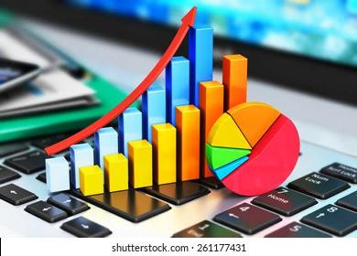

STATISTICS
Statistics is a branch of mathematics that deals with collecting, analyzing, interpreting, presenting, and organizing numerical data.
It involves methods for summarizing data, drawing conclusions from it, and making decisions based on the analysis.

Slide 3

TYPES OF STATISTICS
Descriptive Statistics
Inferential Statistics
Probability theory
Hypothesis testing
Regression analysis

Slide 4
DESCRIPTIVE STATISTICS
INFERENTIAL STATISTICS
Draws inferences from data to make predictions.
Describes and summarizes data.
PROBABILITY THEORY
HYPOTHESIS TESTING
Understanding uncertainty and randomness in data, which is fundamental for modeling and prediction.
Assessing the validity of assumptions and conclusions about data, helping to draw reliable conclusions.
REGRESSION ANALYSIS
Modeling the relationship between variables and making predictions based on those relationships.

Slide 5
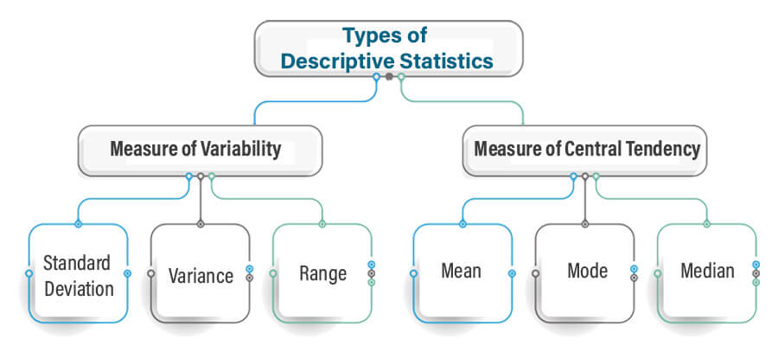
DESCRIPTIVE STATISTICS
Descriptive statistics is a branch of statistics that deals with summarizing and describing the main features of a dataset.
It helps to organize and simplify large amounts of data, making it easier to understand and interpret.

Slide 6
MEASURES OF CENTRAL TENDENCY - MEAN
Mean: The arithmetic average of a set of values. It is calculated by summing up all the values and dividing by the total number of values.
EXAMPLE
Mean = (Sum of all numbers) / (Total number of values)
Let's say you have a set of numbers: 5, 10, 15, 20, 25.
To find the mean:
Sum up all the numbers: 5 + 10 + 15 + 20 + 25 = 75
Count the total number of values: 5
Mean = 75 / 5 = 15
So, the mean of the set of numbers 5, 10, 15, 20, 25 is 15.

Slide 7
MEASURES OF CENTRAL TENDENCY - MEDIAN
The middle value of a dataset when it is ordered from least to greatest. If there is an even number of observations, the median is the average of the two middle values.
EXAMPLE
Let's take the set of numbers: 10, 15, 20, 25, 30, 35, 40, 45.
To find the median of this set, follow these steps:
First, arrange the numbers in ascending order: 10, 15, 20, 25, 30, 35, 40, 45.
Since the total number of values in the set is even (8 numbers), the median will be the average of the two middle numbers.

Slide 8
MEDIAN - EXAMPLE
If the total number of values in the set is odd, the median will be the middle number (at the position of (n+1)/2, where ‘n’ is the number of values).
Here, the two middle numbers are 25 and 30.
Calculate the average of 25 and 30: Median = (25 + 30) / 2 = 55 / 2 = 27.5
So, the median of the set of numbers 10, 15, 20, 25, 30, 35, 40, 45 is 27.5

Slide 9
MEASURES OF CENTRAL TENDENCY - MODE
The value that appears most frequently in a dataset.
EXAMPLE
Let's take the set of values: 10, 15, 20, 25, 30, 15, 35, 40, 15, 45, 50
To calculate the mode, we need to find the number that appears most frequently in the set.
In this set, the number 15 appears three times, which is more frequent than any other number.
So, the mode of the set is 15.

Slide 10
MEASURES OF VARIABILITY- RANGE
The difference between the largest and smallest values in a dataset. It provides a simple measure of the spread of data.
EXAMPLE
Let's consider a dataset: {12, 5, 18, 7, 9, 25}
Minimum value = 5
Maximum value = 25
Range = Maximum value - Minimum value = 25 - 5 = 20
So, the range of the dataset is 20.

Slide 11
MEASURES OF VARIABILITY -
STANDARD DEVIATION
A measure of the amount of variation or dispersion in a set of values.
To calculate the standard deviation of a set of values, use the following steps:
Find the mean (average) of the data set.
For each value in the data set, subtract the mean and square it.
Find the mean of the squared differences.
Take the square root of the result from step 3.

Slide 12
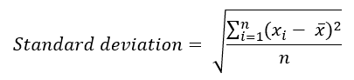
MEASURES OF VARIABILITY-SD
Here's the formula for standard deviation:
where
'xi' represents each individual value in the data set.
'n' represents the number of values in the data set.
Suppose we have the following data set: {2, 4, 4, 4, 5, 5, 7, 9}
Find the mean: (2+4+4+4+5+5+7+9)/8 = 40/8 = 5
Calculate mean of squared differences = (9+1+1+1+0+0+4+16)/8 = 32/8 = 4.
Take the square root: Standard deviation = 2.

Slide 13
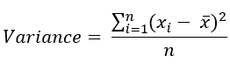
MEASURES OF VARIABILITY-VARIANCE
Here's the formula for standard deviation:
where
'xi' represents each individual value in the data set.
'n' represents the number of values in the data set.
Suppose we have the following data set: {2, 4, 4, 4, 5, 5, 7, 9}
Find the mean: (2+4+4+4+5+5+7+9)/8 = 40/8 = 5
Calculate mean of squared differences = (9+1+1+1+0+0+4+16)/8 = 32/8 = 4.

Slide 14

INFERENTIAL STATISTICS
Make inferences about population.
Inferential statistics is a branch of statistics that uses sample data to make inferences or predictions about a population.
How to generalize?
It allows to draw conclusions or generalize about a population based on a sample, often through hypothesis testing and estimation.

Slide 15
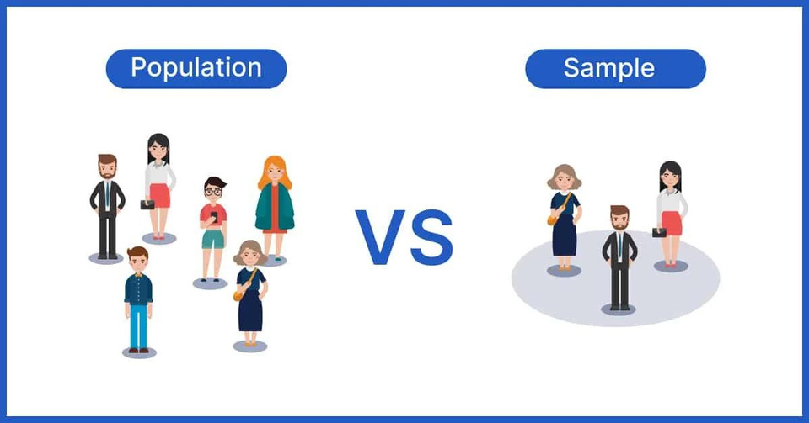
POPULATION & SAMPLING
Population: Population refers to the entire group of individuals, items, or observations under study.
Sampling: Sampling involves selecting a subset of individuals, items, or observations from the population for study. The subset selected for study is known as the sample.

Slide 16

TYPES OF SAMPLING METHODS
Probability Sampling
Simple random sampling
Stratified sampling
Cluster sampling
Systematic sampling
Non-Probability Sampling
Convenience sampling
Quota sampling
Purposive sampling
Snowball sampling

Slide 17
PROBABILITY
SAMPLING
NON-PROBABILITY
SAMPLING
Probability Sampling involves selecting respondents randomly to participate in surveys or other types of studies.
It works well regardless of the population size.
In this method, every member of the population has an equal chance of being chosen for the study.
Probability sampling is widely used in public opinion research, election polling, and other studies intended to be generalized to a larger population.
Non-Probability Sampling involves creating a sample using non-random methods, such as approaching people on the street or emailing surveys to acquaintances.
This method involves participants from specific lists or targeted groups.
It is commonly used in exploratory and qualitative research, as well as for studies focusing on specific groups.
It is time and cost-effective than probability sampling, but its accuracy depends on various factors.

Slide 18
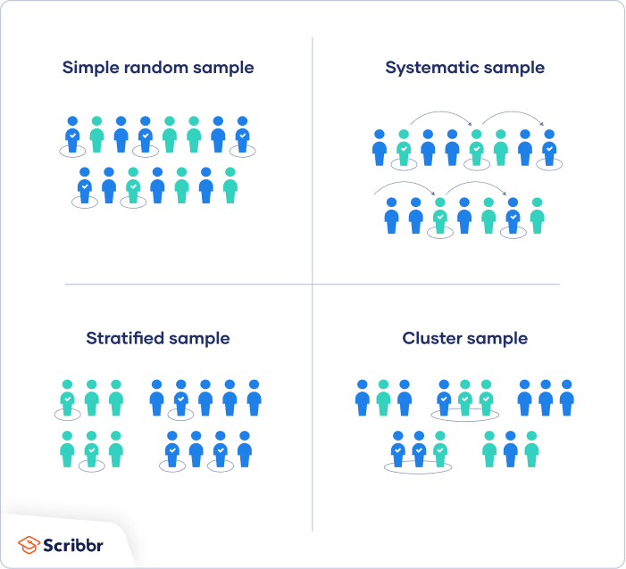
PROBABILITY SAMPLING
Simple Random Sampling: Samples are chosen randomly often with the aid of automated software.
Stratified Random Sampling: Samples reflect the diverse composition same as the proportion of the entire population.
Cluster Sampling: Here, the population is divided into distinct clusters, often based on geographical regions like cities.
Systematic Sampling: It involves selecting participants at regular intervals using a predetermined system.

Slide 19
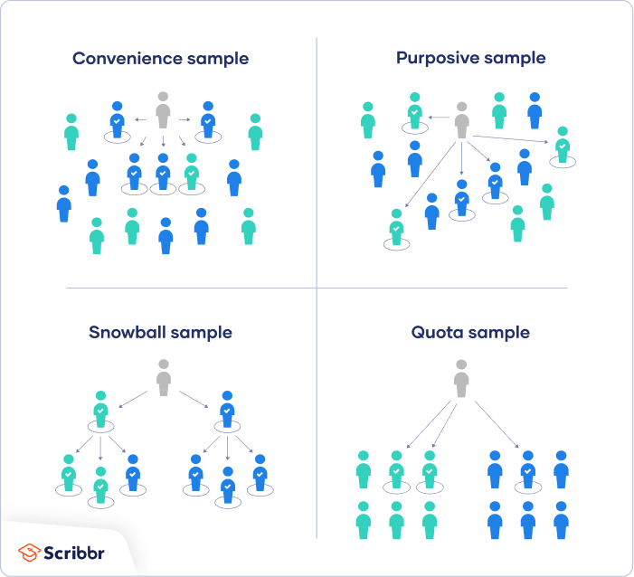
NON-PROBABILITY SAMPLING
Convenience Sampling: This method relies on easily accessible research participants, such as friends, passersby, or university students.
Snowball Sampling: In snowball sampling, initial participants recruit others from their own networks to join the sample.
Quota Sampling: Samples are divided based on factors like geography or age, with predetermined response goals set for each subgroup.
Purposive or Judgmental Sampling: Samples are selected based on the judgment of who meets the study's eligibility criteria.

Slide 20
APPLICATIONS OF SAMPLING
Sampling is extensively used in market research to understand consumer preferences, behaviors, and trends.
Sampling is employed in conducting opinion polls and surveys to gauge public opinion on political issues, social issues, and consumer preferences.
Sampling is used in quality control processes to assess the quality of manufactured products.
Sampling is applied in medical research to study the effectiveness of treatments, medications, and interventions.
Sampling is utilized in environmental studies to monitor air and water quality, assess pollution levels, and study biodiversity.

Slide 21
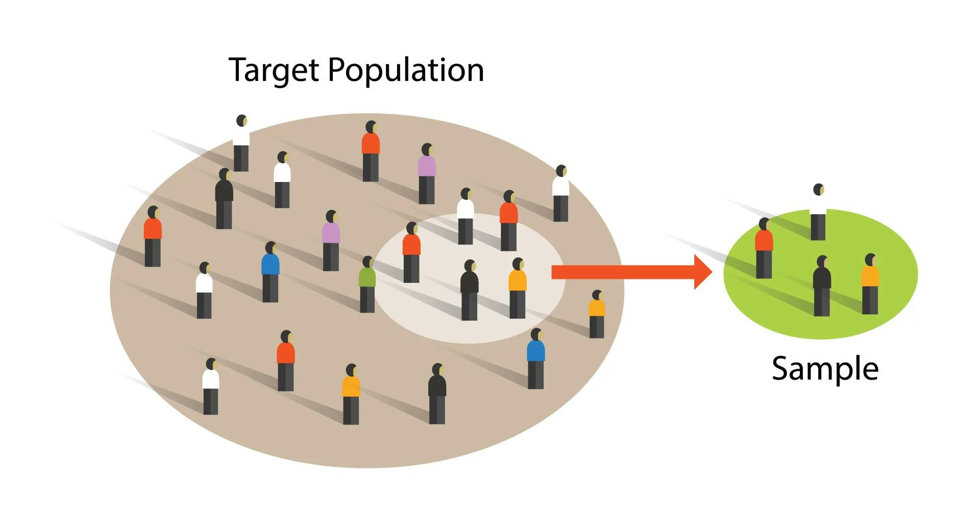
QUESTIONS
You want to conduct a study on the eating habits of college students across different majors. You have limited time and resources. Which sampling method would you choose and why?
You are conducting research on the impact of social media usage on mental health among adolescents. You want to ensure diversity in your sample and have access to a large population. Which sampling method would be most appropriate?
You aim to study the effectiveness of a new teaching method in a school district with varying socioeconomic backgrounds. How would you select your sample to ensure representation from different income levels?

Slide 22
THANK YOU

